Slide 1
Text Emotion Analysis
公衛所 碩二 徐紫絨
公衛所 碩二 林于婷
公衛所 碩二 楊翊萱

Slide 2
Text-Emotion-Analysis
Detect the different types of emotions contained in a collection of English sentences or a large paragraph and then accurately predict the overall emotion of the paragraph.
Emotions of five classes：Neutral、Happy、Sad、 Love、Anger
Notes:
Text-Emotion-Analysis 是一個開發基於規則和深度學習算法的項目，旨在首先適當地檢測一組英文句子或一個大段落中包含的不同類型的情感，然後準確預測段落的整體情感.
帶有五類標記的情緒：中性、快樂、悲傷、愛、憤怒。

Slide 3
ML Algorithms
In the two classifiers, using the following models:
Count vectorizer
TF-IDF vectorizer
In each classifiers, using the three models:
Multinomial Naive Bayes Classifier
Linear support vector machine
Logistic Regression

Slide 4
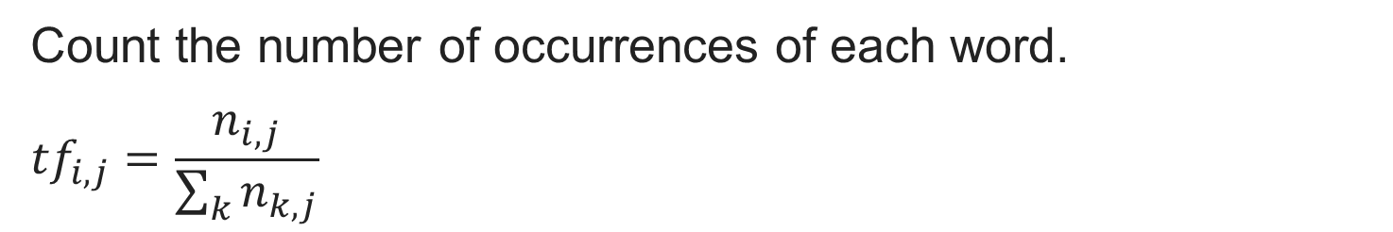
Count vectorizer
Count the number of occurrences of each word.
$${tf}_{i,j}=\frac{n_{i,j}}{\sum_{k}{n_{k,j}}}$$
Notes:
對於每一個訓練文字，它只考慮每種詞彙在該訓練文字中出現的頻率。
把單詞出現的次數作為特徵對文本進行特徵值化
ngram_range片語切分的長度範圍

Slide 5
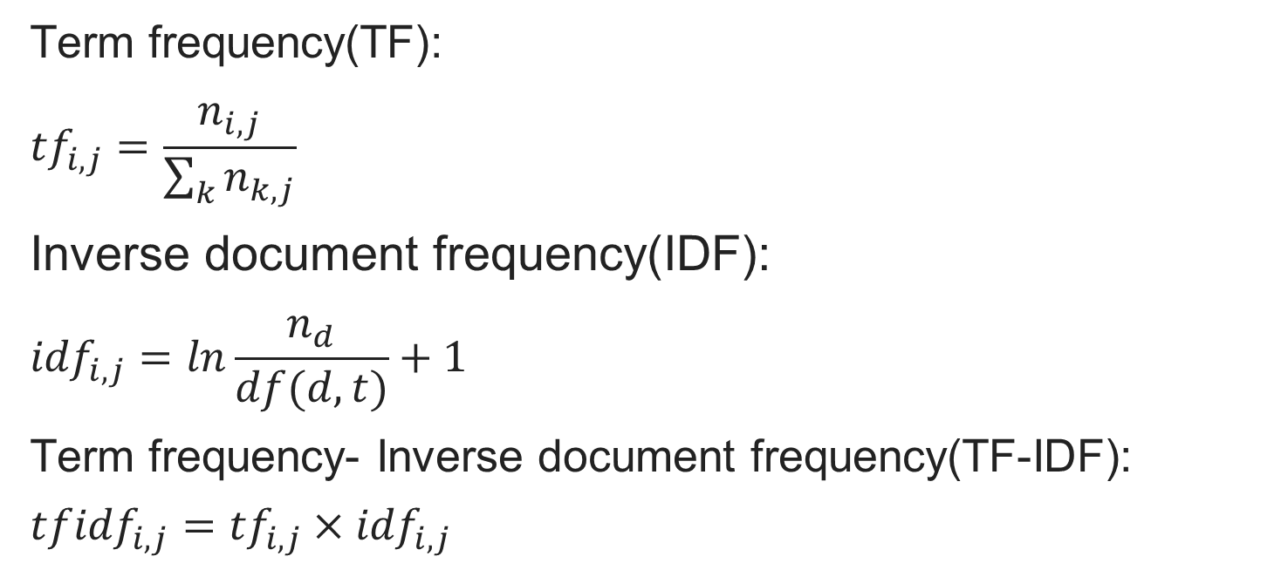
TF-IDF vectorizer
Term frequency(TF):
$${tf}_{i,j}=\frac{n_{i,j}}{\sum_{k}{n_{k,j}}}$$
Inverse document frequency(IDF):
$${idf}_{i,j}=ln\frac{n_{d}}{df(d,t)}+1$$
Term frequency- Inverse document frequency(TF-IDF):
$${tfidf}_{i,j}={tf}_{i,j}×{idf}_{i,j}$$
Notes:
TF-IDF的主要思想：如果某個詞或短語在一篇文章中出現的概率較高，並且在其他文章中很少出現，則認為此詞或者短語具有很好的類別區分能力，適合用來分類
term frequency-inverse document frequency vectorizer(TF-IDF vectorizer)
將文字轉換為向量的方式
TF：特定單字在文件出現次數/文件總次數
但TF可能讓一些定冠詞，或是常用單字，像是a, an, the, and, or 等等，得到很高的分數，所以用IDF。
$n_{d}$: 訓練集的文件數量
$df\left(d,t\right)$：包含單字t的文件數量
IDF會去計算一個字出現在文件的頻率倒數，這表示出現頻率越高，出現在越多文件之中，但是得分會越低，所以可以降低定冠詞的分數。
再透過TF和IDF相乘(TFxIDF)，得到的綜合分數
(某一特定文件內的高詞語頻率，以及該詞語在整個文件集合中的低文件頻率，可以產生出高權重的TF-IDF。因此，TF-IDF傾向於過濾掉常見的詞語，保留重要的詞語。)

Slide 6
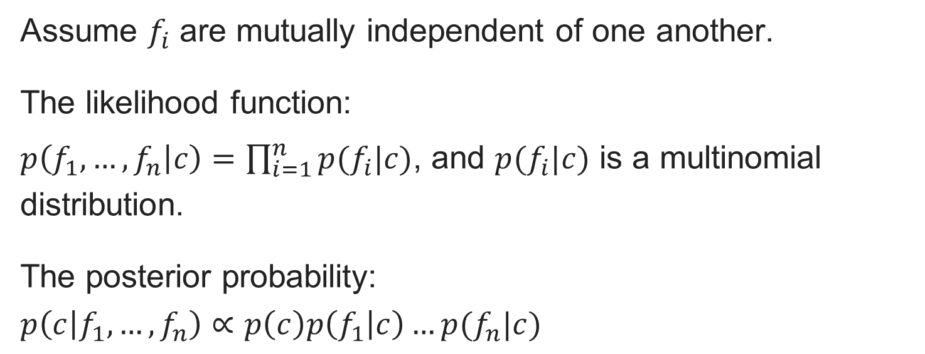
Model 1:
Multinomial Naive Bayes Classifier
Assume $f_{i}$ are mutually independent of one another.
The likelihood function:
$p\left(f_{1},…,f_{n} | c\right)=\prod_{i=1}^{n}{p(f_{i}|c)}$, and $p(f_{i}|c)$ is a multinomial distribution.
The posterior probability:
$$p\left(c | f_{1},…,f_{n}\right)∝p\left(c\right)p\left(f_{1} | c\right)…p(f_{n}|c)$$
Notes:
樸素貝葉斯分類器是一個基於貝葉斯定理的比較簡單的概率分類器，其中 naive（樸素）是指的對於模型中各個 feature（特徵） 有強獨立性的假設，並未將 feature 間的相關性納入考慮中。
The strong independence assumptions in the model
計算P(word|Ci)，在某個類别下單字出现的機率。
貝氏分類器中的“naive”指的是，我們對每個標籤的生成模型做原是的假設，然後對模型中的每個類別做大約估計，不同類型的數據假設依賴於不同類型的貝氏分類器。

Slide 7
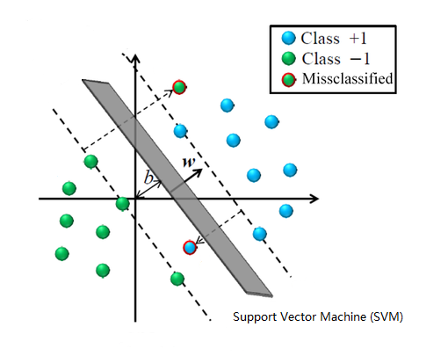
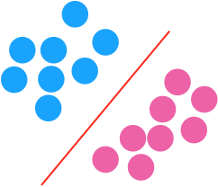
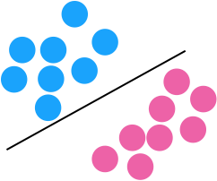

Model 2:
Linear support vector machine
Notes:
利用hyperplane分類，如果不同類別文件之間本身就相距不遠的話，這種超平面也就找不到，當然效果就不好。
SVM就是通過尋找Margin最大的那個紅線，來找最好的線

Slide 8
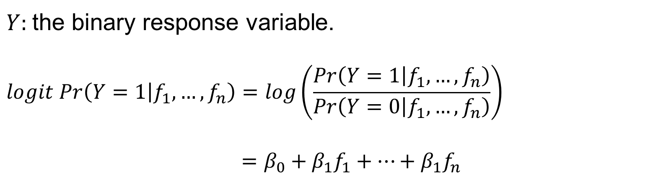
Model 3:
Logistic Regression
$Y$: the binary response variable.
$$logit Pr\left(Y=1 | f_{1}, …, f_{n}\right)=log\left(\frac{Pr\left(Y=1 | f_{1}, …, f_{n}\right)}{Pr\left(Y=0 | f_{1}, …, f_{n}\right)}\right)$$
$$=β_{0}+β_{1}f_{1}+…+β_{1}f_{n}$$

Slide 9
Deep Learning
Bidirectional LSTM
Convolutional Neural Network

Slide 10
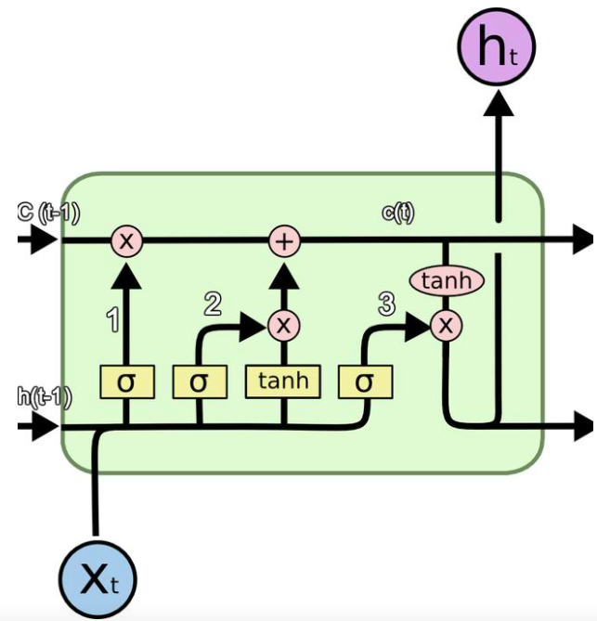
LSTM(Long short-term memory)

Slide 11
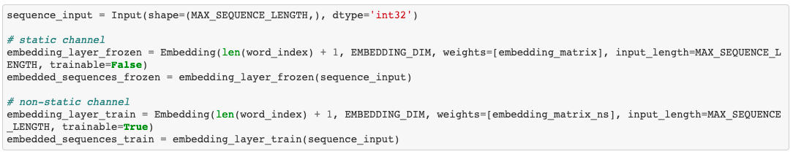
DL Model

Slide 12
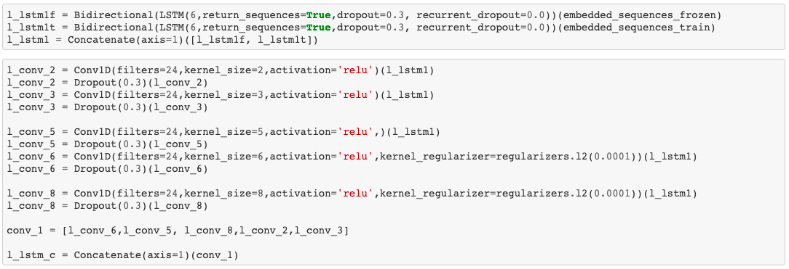
DL Model

Slide 13
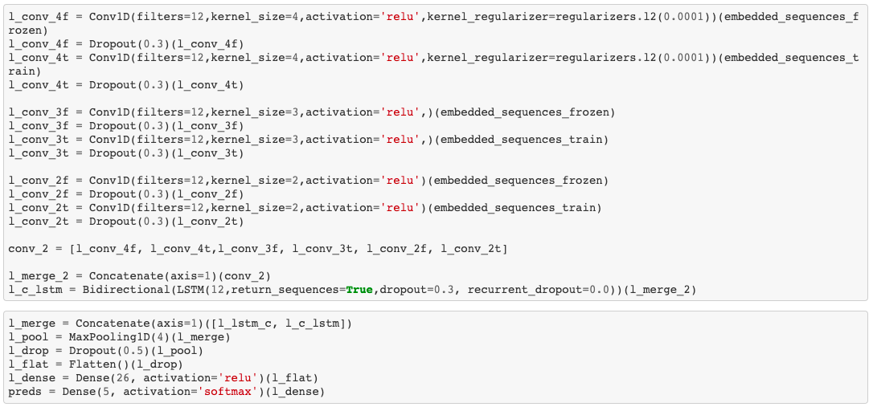
DL Model

Slide 14
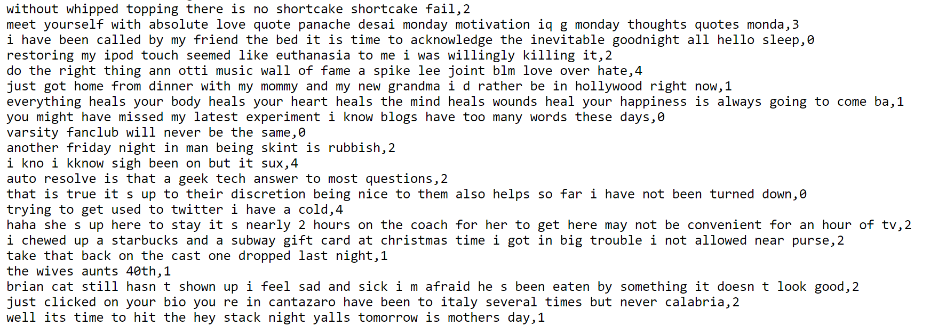
Training & Validation
emotion_data_prep.csv in which more deep pre-processing of tweets in done (lemmatization, removal of stopwords, etc). This dataset is comprised of 62,015 tweets from Twitter with labelled emotions of five classes:
Neutral, Happy, Sad, Love, Anger.
Notes:
訓練跟驗證資料集是蒐集6萬多筆的推特 去判斷牠的情緒 在每一筆後面會標記
實際檔案長得像下面這樣 最後面的01234數字表示的就是情緒

Slide 15
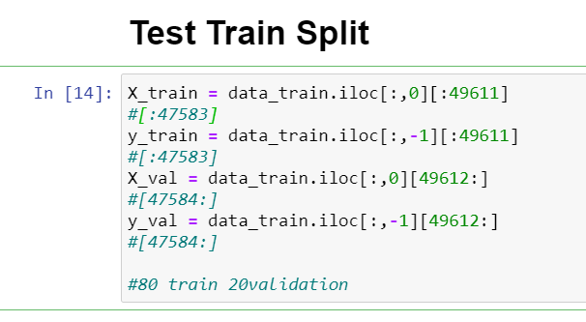
Training & Validation
Dataset size: 62015
Training：80% (49611)
Validation：20% (12403)
Notes:
將80%的資料大概快5萬筆當作訓練 剩下的20%大概12500筆當作驗證

Slide 16
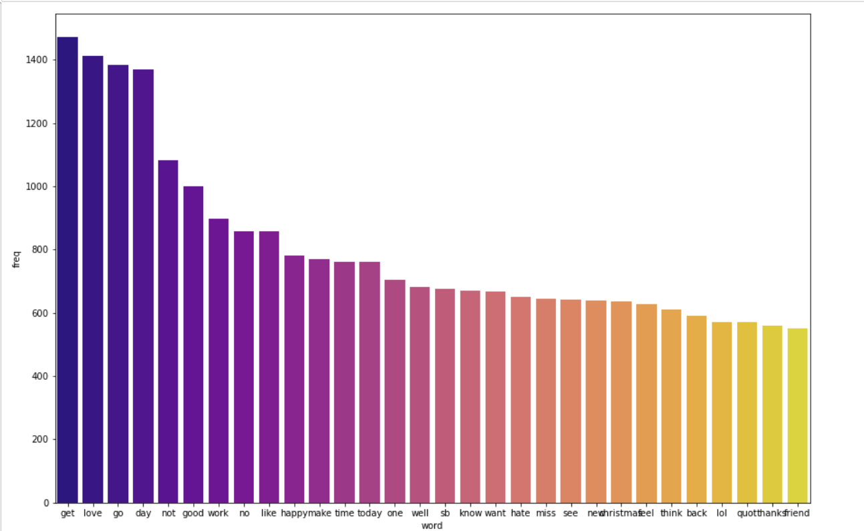
TF-IDF Vectorizer
Notes:
這是用TFIDF去計算向量之後的前30高頻率的結果圖 前5個是get love go day not

Slide 17
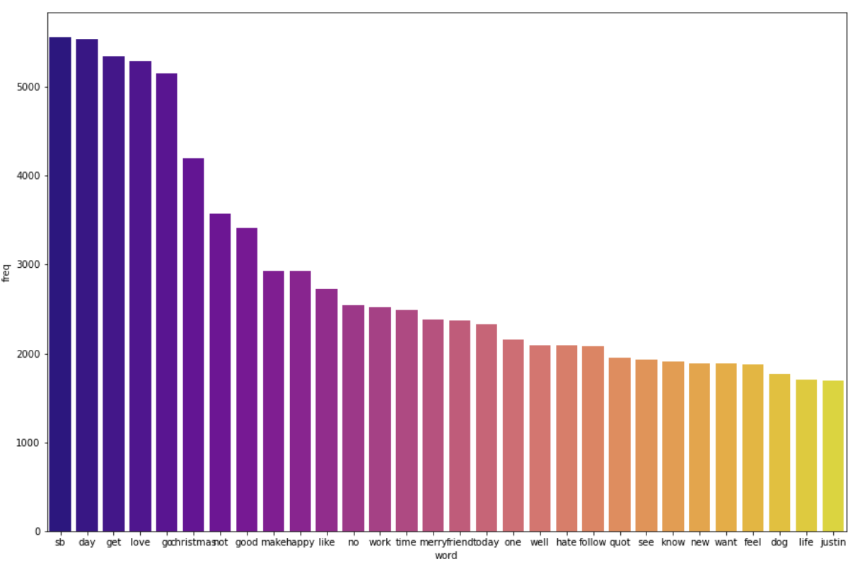
Count Vectorizer
Notes:
如果單純用次數計算頻率 前五高的則是 sb day get love go
和TFIDF的結果稍微有點差異

Slide 18
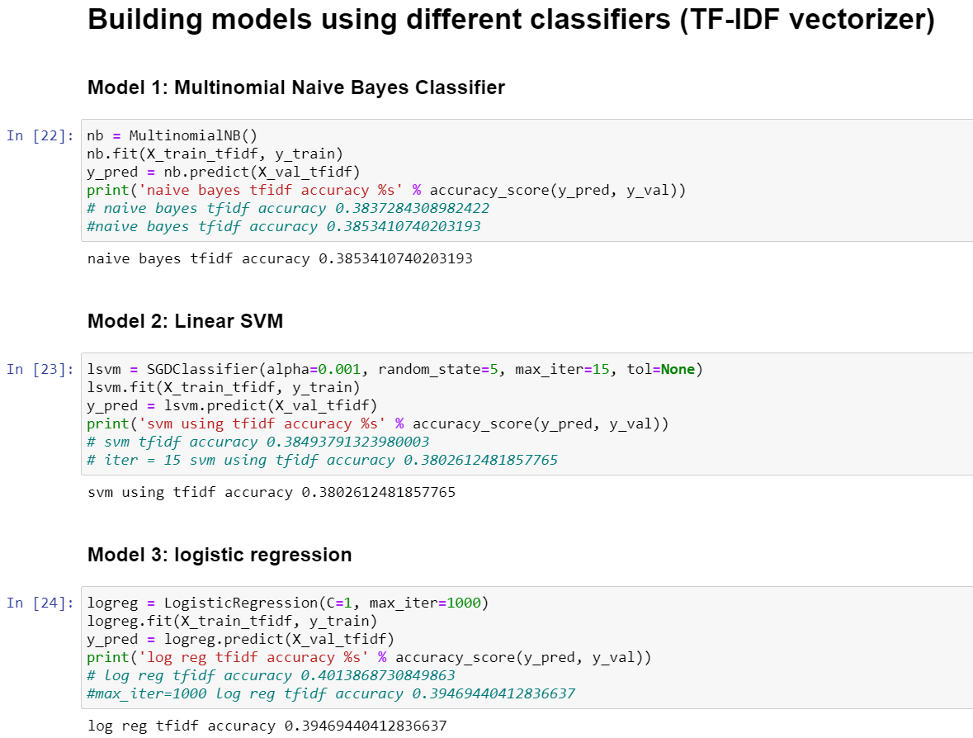
Notes:
用TFIDF像量化後計算的ML準確率
貝氏分類器 是0.385
SVM是0.38
羅吉斯回歸是0.39
3個方法的準確度都不高

Slide 19
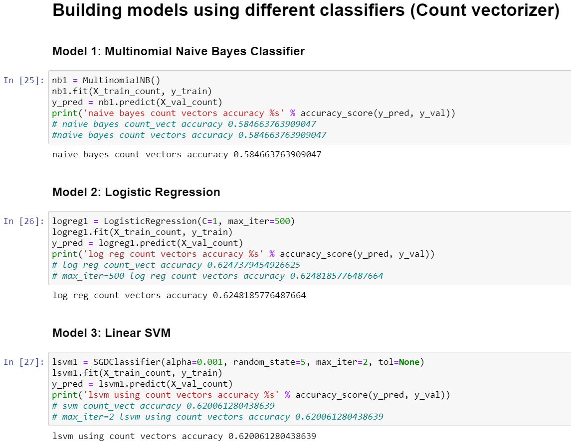
Notes:
如果是用次數向量化的話
貝是分類器的準確度 0.58
SVM是0.62
羅吉斯回歸是0.625
綜合下來看羅吉斯回歸加上次數向量化的模型的準確率是最高的

Slide 20
Testing
"For instance, giving a kiss to your younger sibling daily after waking up in the morning and showing him how much you love them. For some happiness means loving life and seeing others happy. While some finds happiness in writing stories. Some conquer happiness in being simple yet the best person they can ever be. Everyone has their own unique way to feel happy by finding things that they never expected to find.",
# happy
"Love is the key to happiness. We all want to lead a happy life. People look around for happiness in power, fashion, wealth, drugs etc. But these things can only give temporary pleasures. The power of love can create miracles. Love can create unity among nations and its citizens. Love is the most beautiful feeling in the world. Love has given different meaning by different people depending upon how they have experienced this wonderful feeling.", # love
"One day I was studying in my room when, all of a sudden, i heard hot words being exchanged between two persons in the street. I paid no attention, thinking it would be a minor quarrel but soon I heard the voices of a large number of people. I peeped from the window and saw that there was a street quarrel. I went downstairs and reached the spot in the twinkling of an eyes. I was at my wits end on seeing that both of them had come to blows. The people were standing around them and enjoying their quarrel but none tried to pacify them.", # sad
"I am so angry at you!!!!!", # anger
"you ve hit a new low with a danger of blm fascist slogan please stop it before too late stop", # anger
"I love my doggg", # love
"I think i'm gonna be sick :'‑(", # sad
"I hate you so much", # anger
"I'm at work", # neutral
"@TheTombert i was watching Harpers Island, lol... there was no vodka involved", # neutral
"sometimes i wish things could go back to the way they were the beginning of last summer", # sad
"it's your 18th birthday finally!!! yippeeeee", # happy
"still waiting in line", # neutral
"aarrgghh - fu*k.....a hose has leaked water all over the new floating floor", # anger
"that b*tch is so ugly", # anger
"oh no he is hospitalised!!!", # sad
Notes:
測試的部分 作者用了16個句子或一段話 去測試

Slide 21
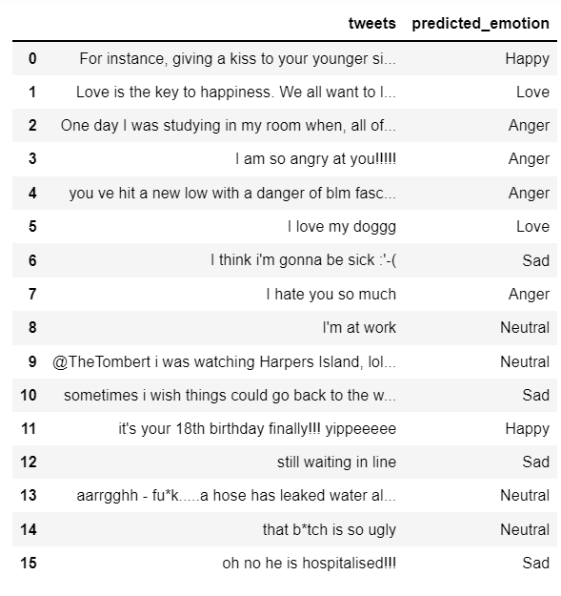
Actual_emotion
# happy
# love
# sad
# anger
# anger
# love
# sad
# anger
# neutral
# neutral
# sad
# happy
# neutral
# anger
# anger
# sad
Notes:
這個是用準確度最高的羅吉斯回歸去預測的結果 在anger的部分 有可能判成沒有特別的情緒

Slide 22
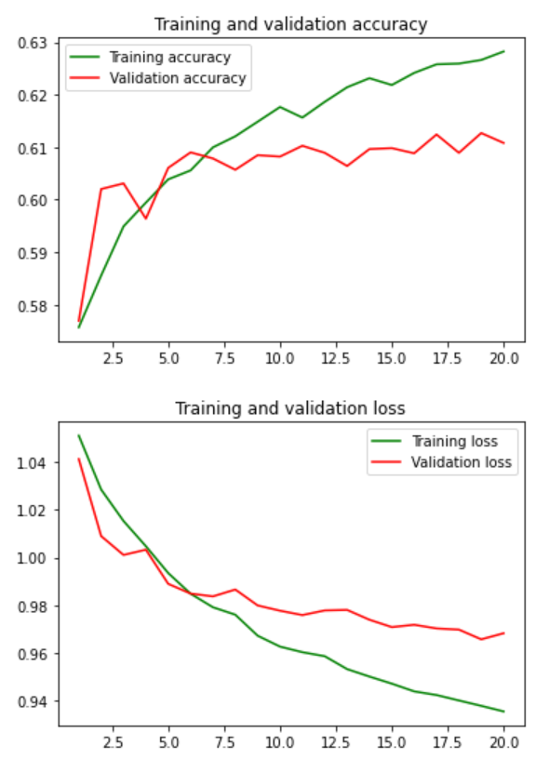
Deep Learning
epochs=20
Accuarcy:0.6127
Notes:
在Deep learning的部分 epochs設為20 準確度大約是0.6127

Slide 23
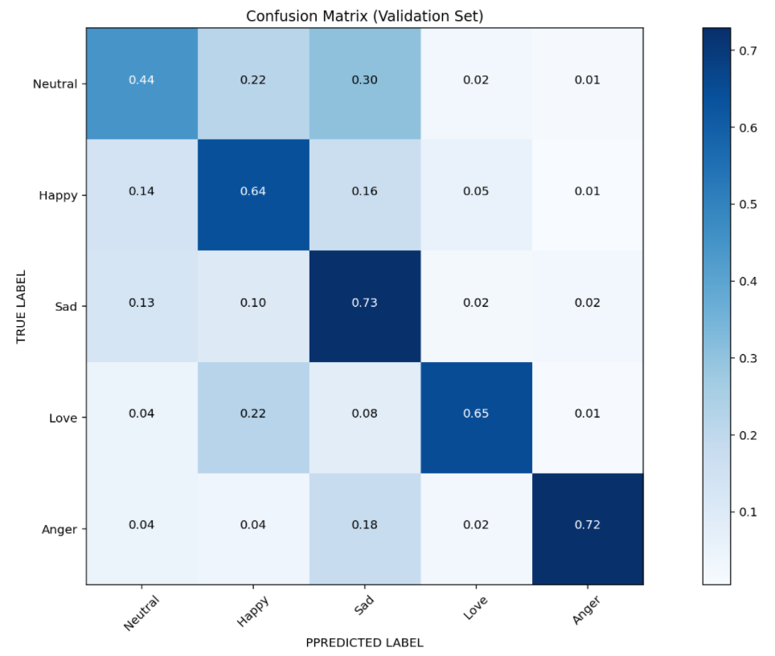
Deep Learning
Notes:
這是訓練的confusion matrix 在預測難過跟生氣的部分比較準確
中立情緒的準確度最低 容易判成難過或是開心

Slide 24
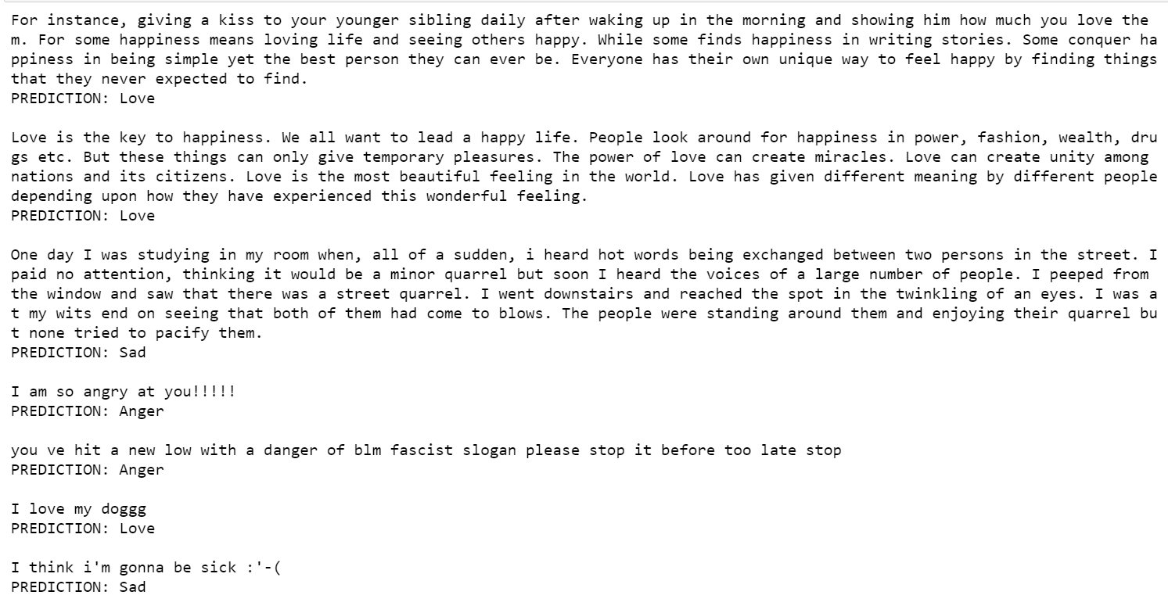
Notes:
一樣和ML用16個推特的文字去做測試 它的結果會長得像這樣 在句子底下寫出預測的結果

Slide 25
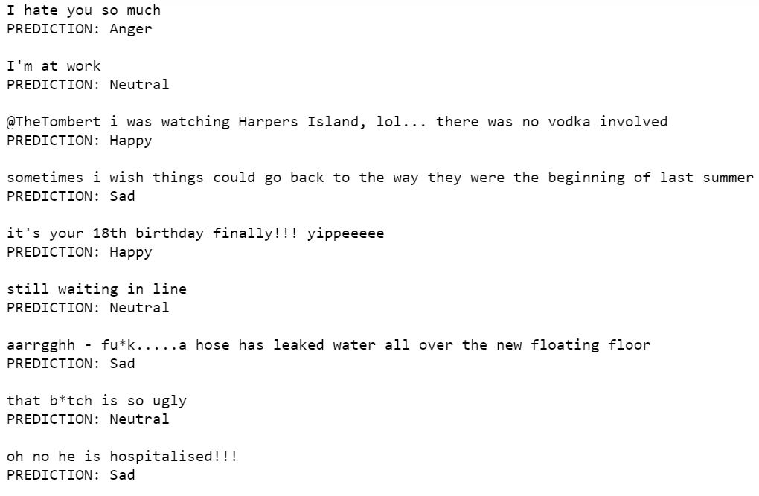
Predict_emotion
Actual_emotion
# love
# love
# sad
# anger
# anger
# love
# sad
# anger
# neutral
# happy
# sad
# happy
# neutral
# sad
# neutral
# sad
# happy
# love
# sad
# anger
# anger
# love
# sad
# anger
# neutral
# neutral
# sad
# happy
# neutral
# anger
# anger
# sad
Notes:
那在DL的測試 在中立情緒可能會判斷成開心 生氣可能會判斷成中立或是難過

Slide 26

Thanks for
your listening
25
25

